Slide 1
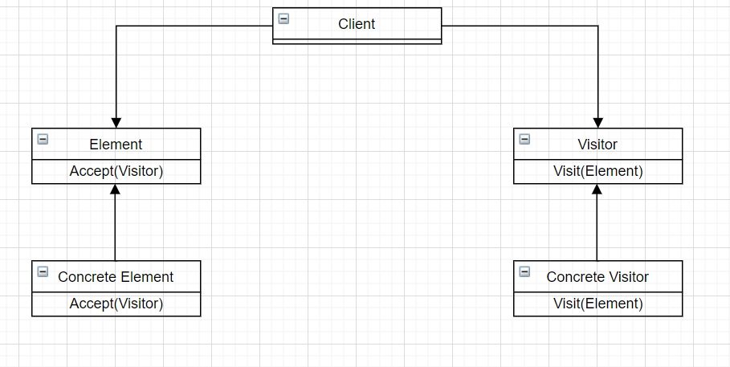
Design Pattern: Visitor
Group 9 – APCS 21 CTT2
Members:
Võ Thanh Phúc – 21125056
Nguyễn Đình Ngọc Trí - 21125065
Nguyễn Minh Vĩ – 21125067
Lê Nguyễn Đăng Khoa - 21125164

Slide 2

What’s inside our presentation?
Content:
Problems and naive solution.
Introduction to Visitor design pattern.
How to solve problem with Visitor.
Similar problem.
Pros and cons to our design pattern.

Slide 3

1. Real-World problem and naive solution
A modern problem that if we use normal-naive solution will cost a lot of efforts, time and may cause some bugs

Slide 4

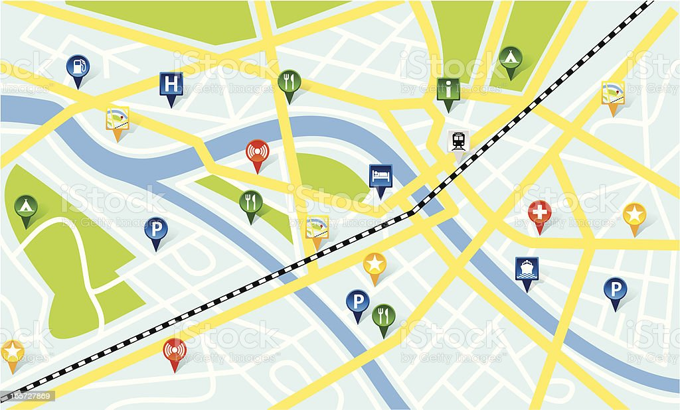
Preview to our Real-world problem
Imagine that you are building an app working with geographic information structured as one colossal graph. Each node of the graph represents a complex entity such as a city, but also more granular things like industries, sightseeing areas, etc. Each node type is represented by its own class, while each specific node is an object.

Slide 5
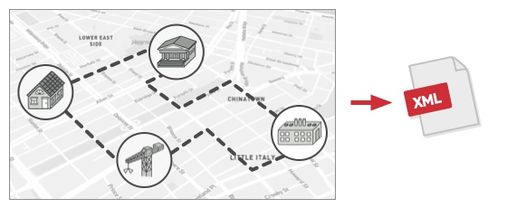
Problem:
From the graph for that city, now , we need to implement to export the graph to XML format.

Slide 6
Naive solution:
You planned to add an export method to each node class and then leverage recursion to go over each node of the graph, executing the export method.
→ This solution was simple.

Slide 7
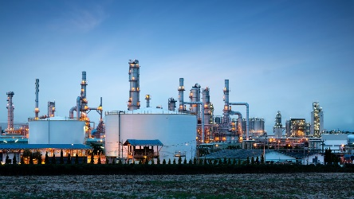



Trouble - Why we shouldn’t use it:
However, the code was already in production and by altering existing node classes, a potential bug in your changes may happens.
Industrial
</>XML Export Implementation
Residential
Existing application’s classses
Commercial
Construction

Slide 8
Print Slide Master
Our PowerPoint templates and backgrounds are «pre-made» presentation shells («pre-made» slides). All design backgrounds, graphics, typefaces, and colors have been created and are pre-set by an expert graphic designers which are working with some of the most prominent businesses in the world.
You simply insert your text. That's it! You just can't go wrong with these templates and backgrounds!
Download this template as well as our others at http://poweredtemplate.com/technology-computers-ppt-powerpoint-templates.html

Slide 9
Print Slide Master
Our PowerPoint templates and backgrounds are «pre-made» presentation shells («pre-made» slides). All design backgrounds, graphics, typefaces, and colors have been created and are pre-set by an expert graphic designers which are working with some of the most prominent businesses in the world.
You simply insert your text. That's it! You just can't go wrong with these templates and backgrounds!
Download this template as well as our others at http://poweredtemplate.com/technology-computers-ppt-powerpoint-templates.html

Slide 10
Print Slide Master
Our PowerPoint templates and backgrounds are «pre-made» presentation shells («pre-made» slides). All design backgrounds, graphics, typefaces, and colors have been created and are pre-set by an expert graphic designers which are working with some of the most prominent businesses in the world.
You simply insert your text. That's it! You just can't go wrong with these templates and backgrounds!
Download this template as well as our others at http://poweredtemplate.com/technology-computers-ppt-powerpoint-templates.html

